Slide 1
Team 808
Scalable ESU
TA Check-In: 2/23/2023

Slide 2
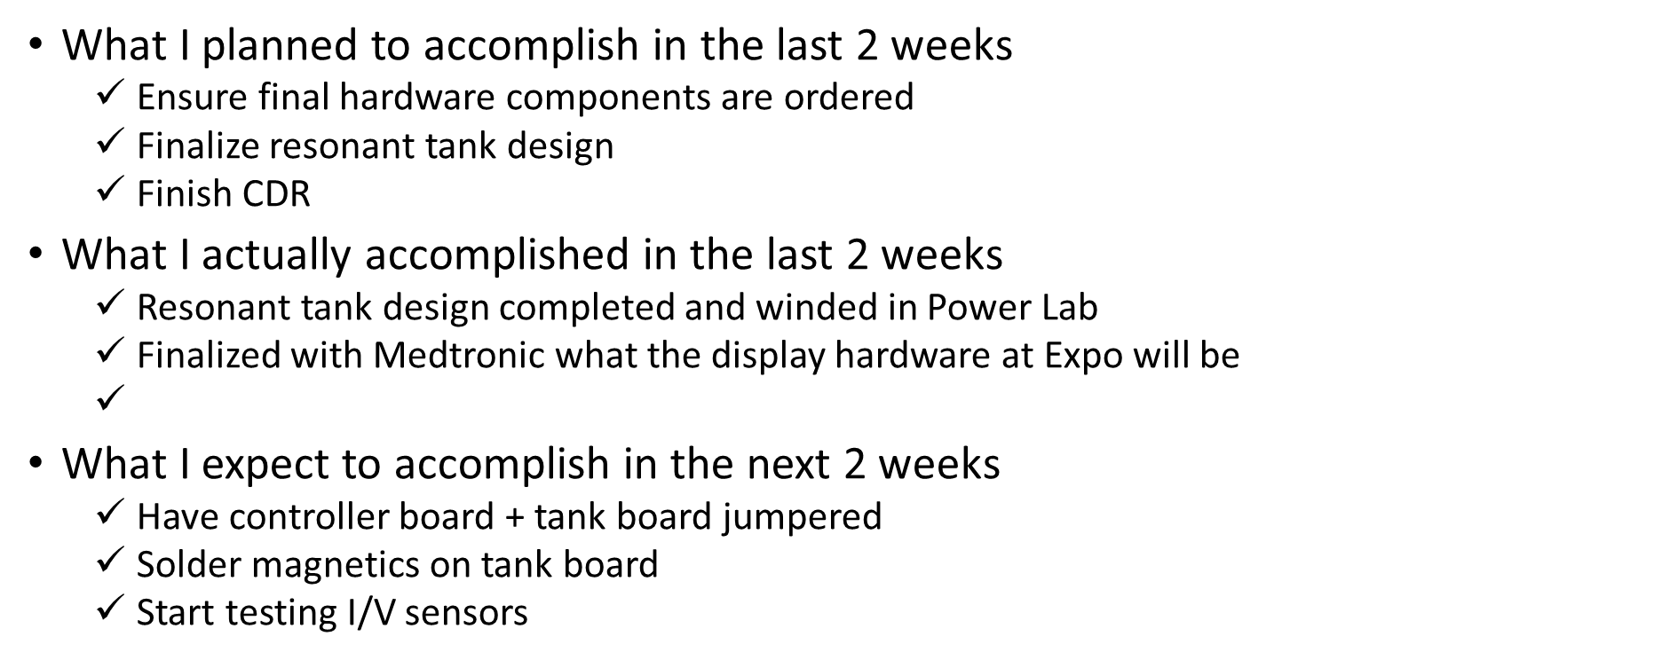
Sonal Tamrakar

Slide 3
Rustin Chang
What I planned to accomplish in the last 2 weeks
Finish CDR
finish winding the transformers and inductors
order parts for the rf tank
What I actually accomplished in the last 2 weeks
Finished the CDR
Finished winding the transformers and inductors
Ordered parts for the RF tank
What I expect to accomplish in the next 2 weeks
Integration test #2
have second pcb assembled
cleaning up wiring setup for testing

Slide 4
Ali Moran
What I planned to accomplish in the last 2 weeks
GUI development
What I actually accomplished in the last 2 weeks
GUI development
GUI testing and debugging
What I expect to accomplish in the next 2 weeks
More thorough GUI testing and cleanup
Solder magnetics custom pcb
product manual update

Slide 5
Steven
What I planned to accomplish in the last 2 weeks
CDR Presentation
Integration Test1
What I actually accomplished in the last 2 weeks
CDR Presentation
Integration Test1
What I expect to accomplish in the next 2 weeks
Synchronization in ADCs

Slide 6
Noah Zhao
What I planned to accomplish in the last 2 weeks
Wind magnetics
CDR
Integration Test 1
What I actually accomplished in the last 2 weeks
Wind magnetics
CDR
Integration Test 1
What I expect to accomplish in the next 2 weeks
Prepare for integration test 2
Product manual revisions

Slide 7
Daniel Chun
What I planned to accomplish in the last 2 weeks
RF Tank prototyping
Purchase all components for RF Tank and Sensors
What I actually accomplished in the last 2 weeks
Purchased all components
Winded transformers
What I expect to accomplish in the next 2 weeks
Finish preparations for RF Tank integration test
Begin preparations for last integration test

